Slide 1
A primer on SC-RNAseq computational analyses
Panagiotis Papasaikas, Atul Sethi
FMI Computational Biology
Basel, 25-01-2018
Single Cell analyses introductory tutorial available at:
https://ppapasaikas.github.io/BC2_SingleCell/

Slide 2
Preprocessing
Data analyses
BAM
Files
UMI correction for overamplification
Quality control /gene filtering
Adapted from Liu and Trapnell
F1000 Res. 2016 Feb 17;5.

Slide 3


The key characteristic / hurdle in SC data is multiple, confounded sources of variance
Multiple Sources of Variance:
Biological:
Cell Type Heterogeneity
Genetics
Cell State/Microenvir.
GExpr Stochasticity
Cell Cycle Dynamics
Transcriptional Bursts
Oscillations
…
Technical:
Capture Efficiency
Amplification Bias
PCR artifacts
Contamination
Cell Doublets
Cell Damage
Sampling (Jackpot Effects)
…
Reproduced according to
Kharchenko et. al, Nat. Methods 2014

Slide 4
Data Filtering 1 (Cell filtering)
The goal is to remove spurious cells (e.g damaged/lysed, apoptotic, doublets… )
Prior information/domain knowledge
e.g cells of interest contain know gene-set signatures
3. Proportion of MT reads (evidence of cell damage)
2. Library size (number of detected genes)
4. Doublets (tough to identify only based on data)

Slide 5
Data Filtering 2 (Gene Filtering)
The goal is to remove uninformative / noisy genes in order to improve cell separability
Based on prior information / domain knowledge
e.g MT and ribosomal genes (typically noisy, BUT depends on the problem)
Retain only gene sets relevant to the problem at hand.
Data-driven:
Based on criteria for over/under-dispersion

Slide 6
Data visualization (cell embedding)
Induced pluripotent stem cells generated from three different individuals (A, B and C) with three replicates of 96 cells each (A.r1, A.r2, A.r3, …). Data from:
Tung et al., Sci. Rep. 2017
non-linear, stochastic projection technique that attempts to find a mapping of the data on a low subspace while preserving local distances between cells.
PCA
linear transformation procedure that identifies the directions of maximum variance
tSNE
Cell population separability can be poor.
First PC(s) often dominated by library size.
Similar cells end up together
Large distances are meaningless.
tSNE space should not be used for clustering

Slide 7
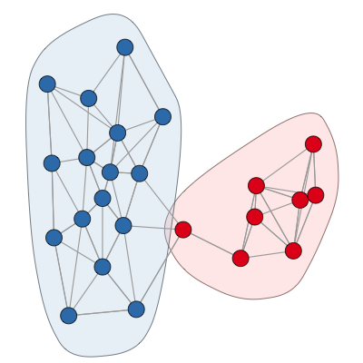
Subpopulation detection (clustering)
Graph-based cell-type identification:
Cells are nodes in a graph
Cell types are coherent “node communities”
Rely on ideas from Network Analytics and Graph Theory
Deal well with continuous distortions
Out-perform density-based approaches
Examples:
PhenoGraph, SNN-cliq, SEURAT, SIMLR, Griph

Slide 8
Identify changes in gene regulation
Typically happens at the level of subpopulations (not single cells)
The fact that we are looking at populations opens the possibility to address questions/make inferences that are impossible using bulk RNAseq.
(e.g Tx stochasticity, Tx bursting…)
Same means
Different variances
Different means
Same variance
Different mean
Different variance
Different
Skewness
Specific methods dealing with the “quirks” of SC data exist but simple non-parametric tests perform rather well…

Slide 9
Removing Unwanted Variation
Use control genes: - spike-ins, housekeeping genes, or endogenous genes (RUVg)
Use replicate/negative control samples (RUVs)
Specify sources of wanted and unwanted variation in a mixed effects linear model (ruv_mixed_model)
Specify sources of unwanted variation as topological constraints in a graph-basel model (griph)
Multiple other methods work on similar principles, eg. BASiCS, scLVM, RUVr, etc.

Slide 10
RUVSeq
Generalized Linear Model framework
Sample offset – sequencing depth
Observed gene level read counts
vector of unwanted variation - cell cycle, chip, library complexity
vector of wanted variation –
Condition /
Treatment / Pathways /
Gene Sets
Explicitly specifying X and W, and let them compete to explain observed expression
Risso et al., Nature Biotech 2014

Slide 11
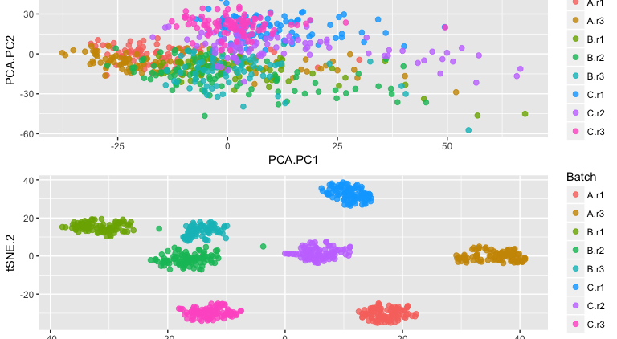
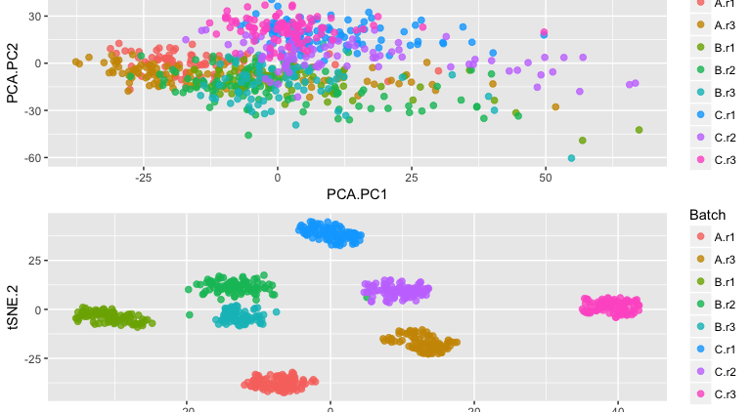
RUVg Using negative control genes (ERCC spike-ins, housekeeping genes)
K=1
K=2
Risso et al., Nature Biotech 2014

Slide 12
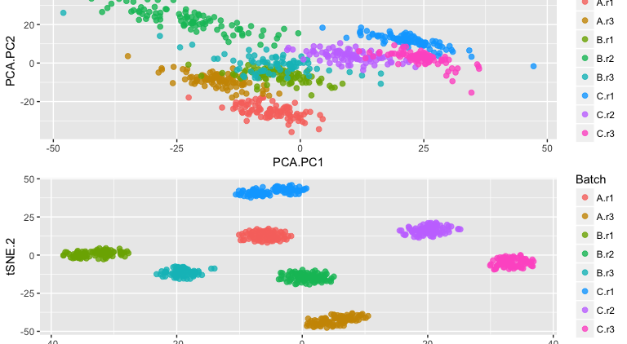
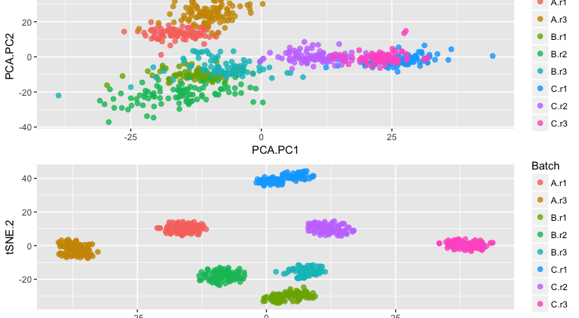
RUVs
Using centered (technical) replicate / negative control samples
K=1
K=2
Risso et al., Nature Biotech 2014

Slide 13
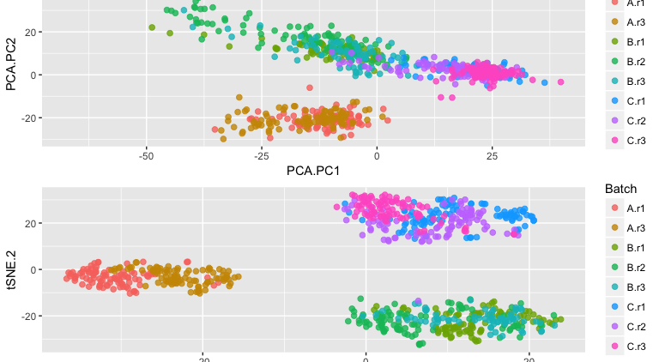
RUV mixed model
Estimates variance components due to random effects
Humanzee package adapted limma’s algorithm for estimating variance components due to random effects.
Assumption: Biological replicates (or batches within an individual in this case) share similar correlation across genes.
For every single gene, fit a mixed model assuming differences between batches are not individual-specific.

Slide 14
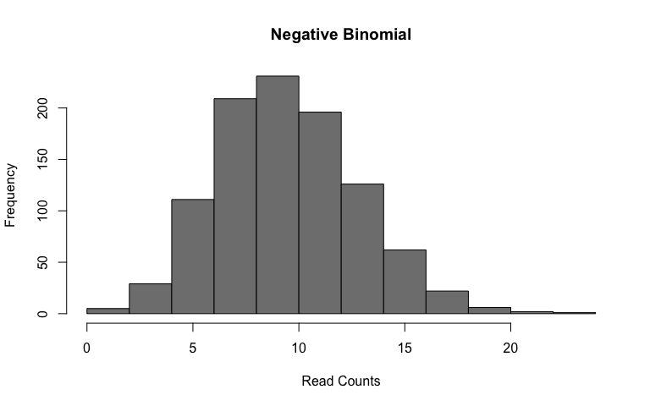
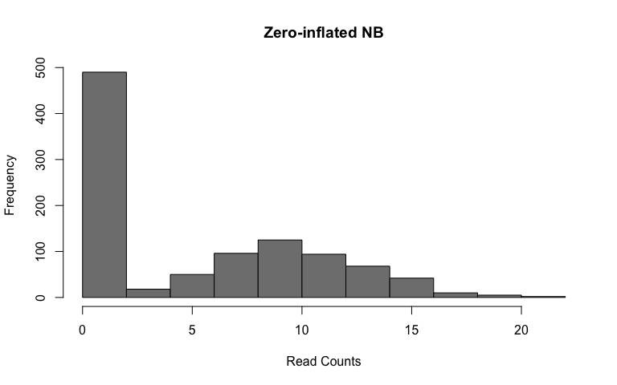
Differential Expression Analyses
Compared to bulk RNA-seq profiles, single cell measurements have a high dropout rates relative to the non-zero read counts.
Negative Binomial Zero-inflated Negative Binomial
Multiple methods using zero-inflated negative binomial (ZINB) models have been proposed (MAST, SCDE).
MAST tests for DE using a hurdle model to combine tests of discrete (0 vs not zero) and continuous (non-zero values) aspects of gene expression. Gene Set enrichment analyses included.
SCDE fits a ZINB model to expression data using Bayesian statistics. (long processing time)
edgeR …

